Slide 1

Decision Tree
By Hitesh
2019201039

Slide 2
Decision Tree
A computational problem is a function whose domain is one set of bit sequences and whose range is another set of bit sequence.
We model such problems as functions f : {0, 1}^n → {0, 1} m for some a priori fixed lengths n and m.
A decision problem is a computational problem with a yes/no answer, like “is graph G connected?”. Such problems are represented by functions f : {0, 1} ∗ → {0, 1} and f : {0, 1} n → {0, 1} in uniform and non-uniform complexity, respectively

Slide 3
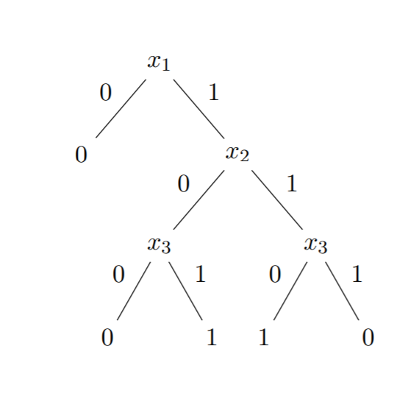
Decision Tree​
A decision tree for inputs of length n is a rooted binary tree whose vertices and edges are labeled as follows. Each of its internal nodes is labeled by one of the variables x1, . . . , xn and its two outgoing edges are labeled by the values 0 and 1 respectively. Each leaf is labeled by a 0 or by a 1. Here is an example:​

Slide 4
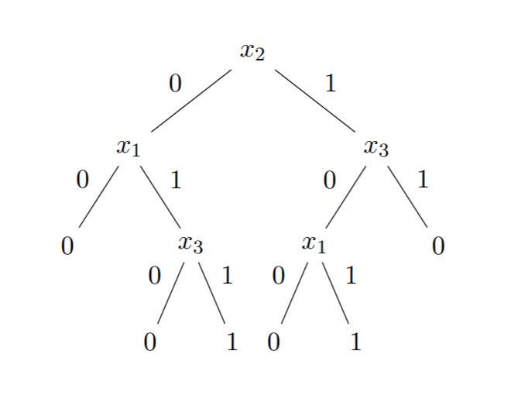
Decision Tree​
x1 and (x2 xor x3).

Slide 5
Decision Tree​
The first decision tree is in some sense preferable than the second one as it is smaller. This is our first example of a complexity measure: The size of a decision tree is its number of leaves.​
​
It is not difficult to see that any function f : {0, 1} n → {0, 1} can be computed by a sufficiently large decision tree.

Slide 6
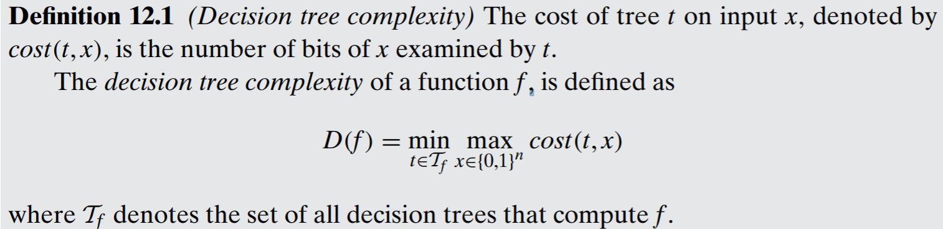
Decision Tree​​ Complexity

Slide 7

Question
Suppose that we are given an m-vertex graph G as input, representedas a binary string of length n = mc2 binary string, with the eth coordinate equal to 1 if the edge e is in G, andequal to 0 otherwise. We wouldlike to know how many bits of the adjacency matrix a decision tree algorithm might have to inspect to determine whether G is connected?

Slide 8
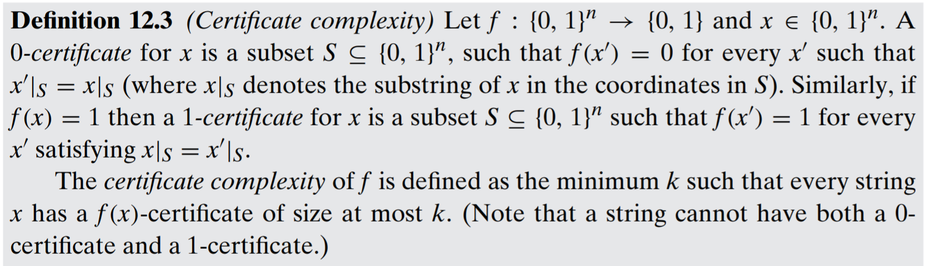
Certificate Complexity

Slide 9
Consider a function f : {0, 1}^n→ {0, 1}.
If f(x)=0 then a 0-certificate for x is a sequence of bits in x that proves f(x)=0.
If f(x)=1, then a 1-certificate is a sequence of bits in x that proves f(x)=1.
Certificate Complexity​

Slide 10
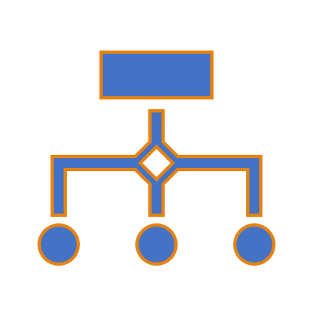
Example
Graph connectivity: Let f be the graph connectivity function. Recall that for an m-vertex graph, the decision tree complexity of f is D(f) = m*(m−1)\ 2 .
A 1-certificate for a graph G is a set of edges whose existence in G implies that it is connected. Thus every connected m-vertex graph G has a 1-certificate of size m − 1—any spanning tree for G.
A 0-certificate for G is a set of edges whose nonexistence forces G to be disconnected—a cut. Since the number of edges in a cut is maximized when its two sides are equal, every m-vertex graph has a 0-certificate of size at most (m/2)^2 = m^2/4.

Slide 11

Resources
https://users.cs.duke.edu/~reif/courses/complectures/Arora/lec17.pdf
http://www.cse.cuhk.edu.hk/~andrejb/csci5170/notes/19L01.pdf
Book: COMPUTATIONAL COMPLEXITY by Sanjeev Arora

Slide 12
Thank You

